Slide 1


Cartland Law & Co.

Slide 2
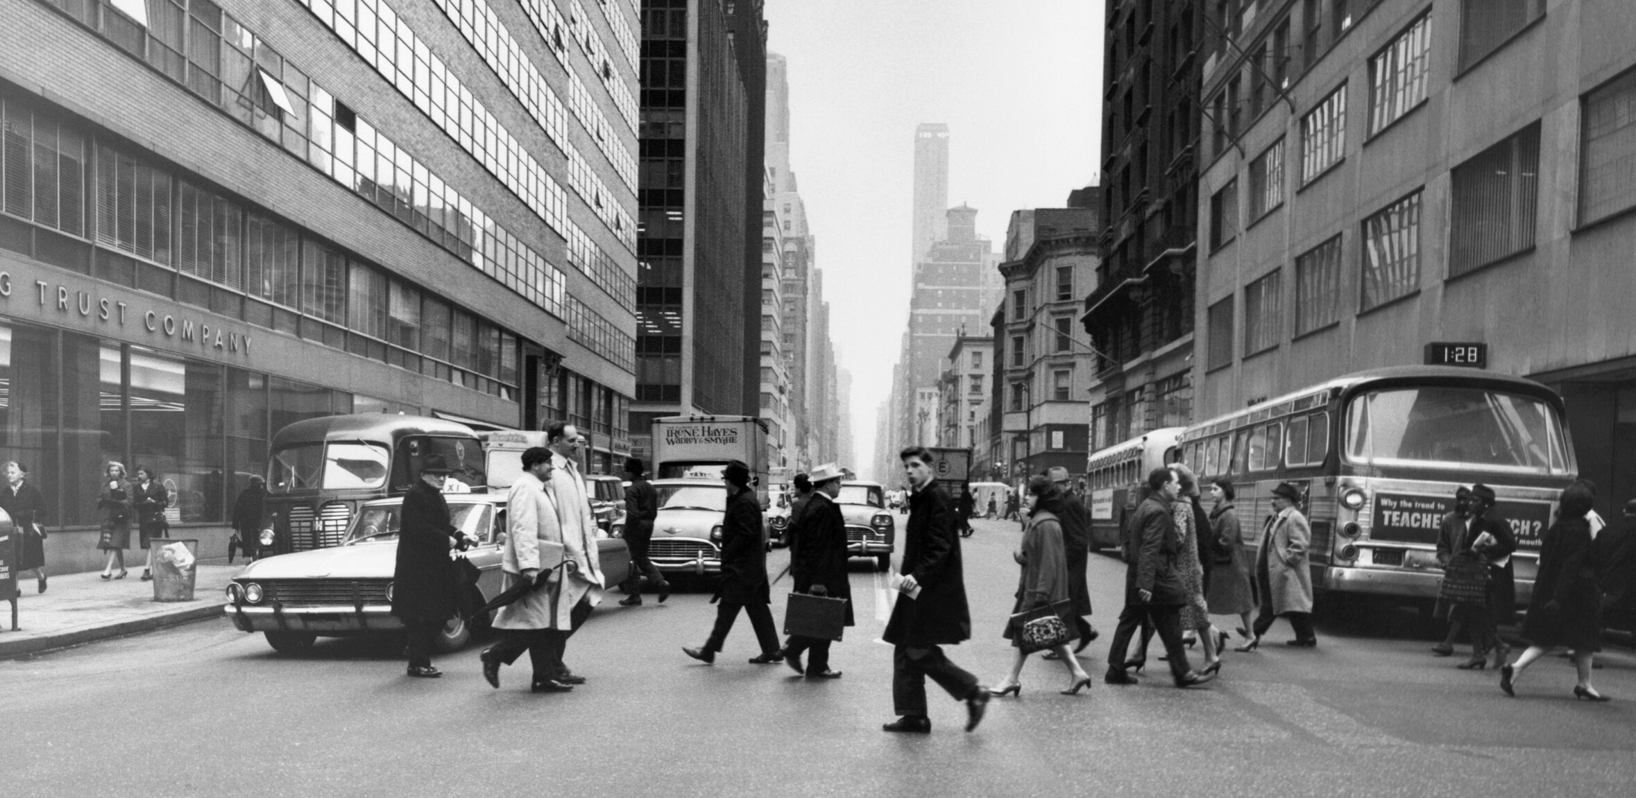
SA Land Tax Changes
Adrian “The Taxinator” Cartland – Cartland Law
04

Slide 3
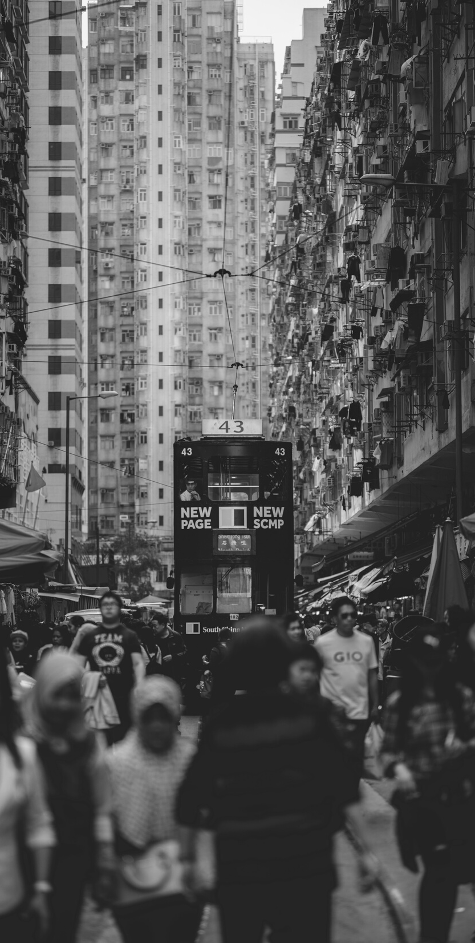
Land Tax Presentation Overview
Old
Titles / ownership
By person / company
Trusts – aggregation
New
Personal
Multi-tier
Trust surcharge
02

Slide 4
Old 2019-20 Rates
Range |  |  | Base amount |  | Rate Per Extra $
0 | to | 391,000 | 0 | + | 0.00%
391,001 | to | 716,000 | 0 | + | 0.50%
716,001 | to | 1,042,000 | 1,625 | + | 1.65%
1,042,001 | to | 1,302,000 | 7,004 | + | 2.40%
1,302,001 | and | over | 13,244 | + | 3.70%
26

Slide 5
New Standard 2020-21 Rates
Range |  |  | Base amount |  | Rate Per Extra $
0 | to | 450,000 | 0 | + | 0.00%
450,001 | to | 755,000 | 0 | + | 0.50%
755,001 | to | 1,098,000 | 1,525 | + | 1.25%
1,098,001 | to | 1,350,000 | 5,812.50 | + | 2.00%
1,350,001 | and | over | 10,852.50 | + | 2.40%
26

Slide 6
New Trust 2020-21 Rates
Range |  |  | Base amount |  | Rate Per Extra $
0 | to | 25,000 | 0 | + | 0.00%
25,001 | to | 450,000 | 125 | + | 0.50%
450,001 | to | 755,000 | 2,250 | + | 1.00%
755,001 | to | 1,098,000 | 5,300 | + | 1.75%
1,098,001 | to | 1,350,000 | 11,302.50 | + | 2.40%
1,350,001 | and | over | $17,350.50 | + | 2.40%
26

Slide 7
Repeals - Jointly held Land - Strata
Old aggregation repealed
Minor interest repealed, except for residential land - s5AA
Where land is jointly held, will be jointly assessed - s9
THEN separately assessed and aggregated
Rebate on proportion – but not negative
Community titles taxed on lowest undivided plan - s10
No tax on common strata property
26

Slide 8
Trusts - Trustee
Separate assessment for Trustee - s11
  Trustee
  Executor
  Administrator
  Guardian
  Liquidator
  Person having possession, administration or control of land, income or property
26

Slide 9
Trusts – Fixed Trusts and Unit Trusts
Fixed trust = not excluded or discretionary trust
Unit Trusts: don’t have to be “fixed” like NSW
  Nominate what type of trust
Nomination of beneficiaries – otherwise trust rate - s12
Taxation first at Trustee level as if only land
THEN Beneficiaries assessed on proportion
Aggregated with other land of beneficiary
Credit on proportion of tax paid by Trustee – no refund
26
General Rates

Slide 10
Trusts – Discretionary Trust
Discretionary Trust = If vesting of the whole or any part of the trust
  To be determined re identity or quantum; or
  Will occur if discretion not exercised
Pre-existing trust, beneficiary, land – before Bill’s intro – s13A
Nomination for all land in trust (except sub-trusts)
Nomination doesn't constitute an eq interest
Nominated beneficiary can change on death
Higher rate for discretionary trusts
Estate planning issues? Divorce? Bankruptcy?
26

Slide 11
Other Trusts
Sub-trust “beneficiary/trustee” is a trustee – s13B
Excluded trust taxed at standard rate – s13C
  Charitable trust
  Concessional trust
  Public unit trust
Super fund or LRBA
Implied or constructive trustee is owner – trust rate only – s13F
Resulting trust?
Is vendor after completion but before title reg a constructive trustee?
26

Slide 12
Principal Place of Residence
Needs to be PPR of all of unitholders or fixed trust bene
Can nominate Disc trust bene with PPR
Does not apply to “beneficiary/trustee”
Minority interest provisions apply <5% and 5% to 50%
Trustee can have land as PPR
26

Slide 13
Nominations
May nominate
  Fixed or Unit trust beneficiaries (if don’t then trust rate)
  Discretionary trust beneficiary (before 30 June 2020)
Must lodge the following within 1 month – s13E
  If become trustee
  If are a trustee when commences
  If trustee disposes of land
  If acquire further land
  If change type of trust
  If fixed or unit trust change beneficial interest or units
  If complete admin of dec’d estate
26

Slide 14
Corporations
Related if control board, or more than 50% of votes or shares – s13H
Controlling interest if persons together can do above
  Share capital doesn’t include fixed returns eg debenture
  Not clear how shares of trustee or nominee of beneficiary treated
  Financier with security is disregarded
Insufficient de-grouping provisions
If grouped are assessed like a single entity: - s13K
  Jointly; or
  Separately; or
  2 or more jointly and remainder separately
26

Slide 15
Structuring Thoughts
Discretionary Trust nomination
  Asset protection – divorce / bankruptcy
  Estate planning
  Income tax/CGT
  Children’s future purchases
  Centrelink?
Unit Trust – no detailed definition
  Not required to be “fixed” like NSW, but unclear
  Income and capital units
  Corpus protection units – keep deductibility for unitholder
  Don’t look beyond nomination of type of trust?
26

Slide 16
Structuring Thoughts … cont
No need to nominate a beneficiary of discretionary trust
Other trust aggregation provisions repealed
One title per trust. Can have same trustee
Anti-avoidance?
SMSF at standard rate
Multiple SMSFs?
Time to sell and buy interstate?
26

Slide 17
Example
  10 properties of $250,000 land value each
Current tax if aggregated:
  $2,500,000 - $1,302,001 = $1,197,999.00 * 3.7% = $44,325.96 + $13,244 = $57,569.96
Current tax is one title per discretionary trust = nil
26

Slide 18
Example … cont
New tax if all assessed at standard rate
  $2,500,000 - $1,098,001 = $1,401,999.00 * 2.4% = $33,647.98 + $7,184.5 = $40,832.48
New tax if all aggregated at trust rate
  $2,500,000 - $1,098,001 = $1,401,999.00 * 2.4% = $33,647.98 + $12,674.5 = $46,322.48
26

Slide 19
Example … cont
New tax if one title per discretionary trust - no nomination
  $250,000 - $25,000 = $225,000.00 * 0.5% = $1,125.00 + $125 = $1,250.00 *10 = $12,500.00
New tax if two titles per discretionary trust - 5 different nominations
  $250,000*2 - $450,000 = $50,000.00 * 0.5% = $250.00 + $125 = $375.00 *5 = $1,875.00
26

Slide 20
Example – Summary
Current tax if aggregated $57,569.96
Current tax one disc trust per title Nil
New tax all std rate $40,832.48
New tax all aggregated trust rate $46,322.48
New tax one title per disc trust $12,500.00
New tax two titles per disc trust w/ 5 noms $1,875.00
26

Slide 21

Questions?
ADDRESS
Unit 5, 72 - 78 Carrington Street, Adelaide 5000
PHONE NUMBER
0403 873 498
EMAIL ADDRESS
adrian@cartlandlaw.com

