Slide 1


Cartland Law

Slide 2
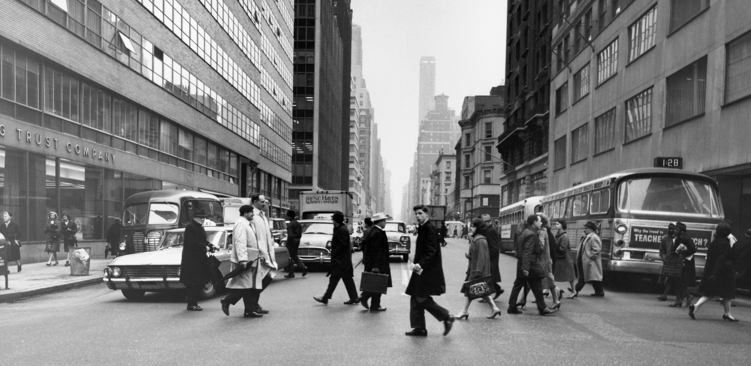
10 Things I Hate About Your Trust Deed
Dr Campbell Rankine
Adrian Cartland
02

Slide 3
Overview
Critical issues – not just drafting preferences
Real examples from SA in the last 10-20 years
De-identified, but true to the original
Why these issues matter
How to improve
03

Slide 4

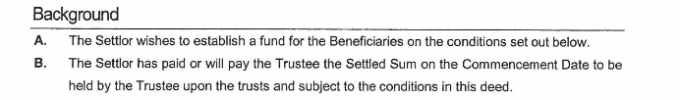

1. I hate your Declaration of Trust
Problematic example:
Problematic example 2:
04

Slide 5
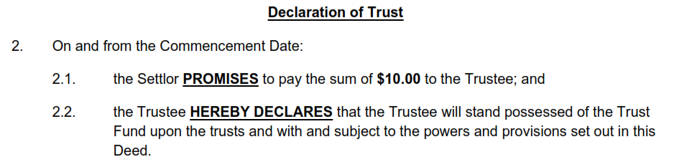
1. I hate your Declaration of Trust
Issue:
Need to declare a Trust – 3 certainties
Improved example:
05

Slide 6
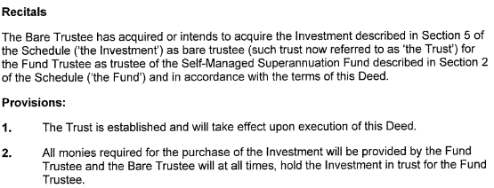
2. I hate your Trust Property
Problematic example:
06

Slide 7
2. I hate your Trust Property
Issues:
No Trust Property – 3 certainties
Making a further declaration – Farrar
Double Stamp Duty
07

Slide 8
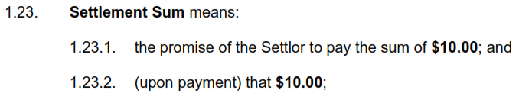
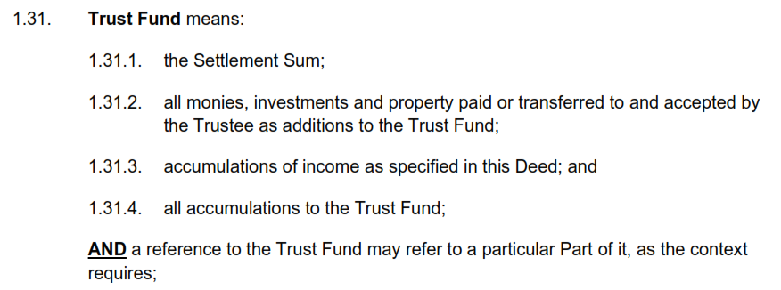
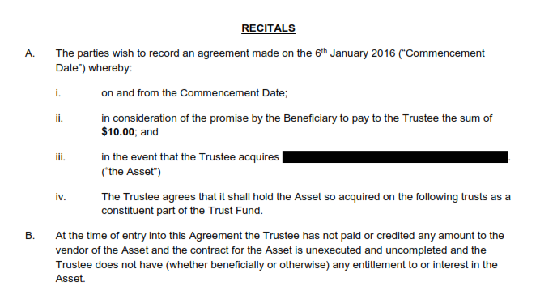
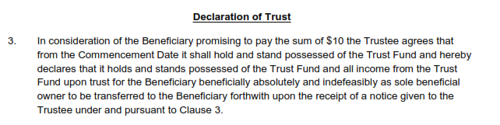
2. I hate your Trust Property
Improved example:
08

Slide 9
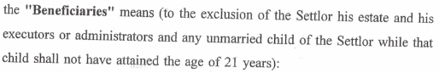
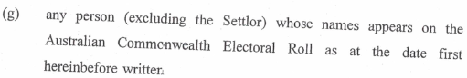
3. I hate your Beneficiaries
Problematic example:
Issue: No certainty of object - unworkable beneficiaries – McPhail v Dalton
09

Slide 10
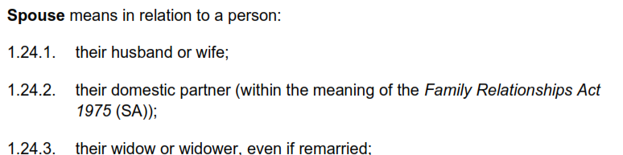
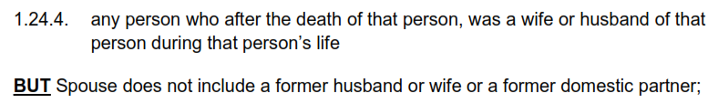
3. I hate your Beneficiaries
Interesting example:
Issue: validly distributing to a former spouse if no longer a beneficiary
10

Slide 11

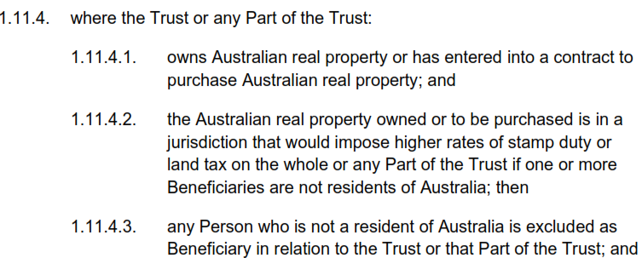
3. I hate your Beneficiaries
Interesting example:
Issue: exclude any foreign beneficiary that would incur surcharge Land Tax or Stamp Duty
11

Slide 12
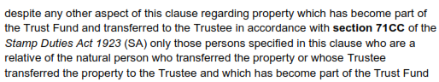
3. I hate your Beneficiaries
Interesting example:
Issue: Reduce beneficiaries to eligible 71CC class for Stamp Duty farmland exemption
12

Slide 13
4. I hate the Wrong Template
Issue:
Incorrect document used
Template examples:
Bare Trust
Fixed Trust
Unit Trust
Discretionary Unit Trust
Class Trust
Discretionary Trust
Land Tax, Stamp Duty, Income Tax, distribution issues
*I could not sufficiently de-identify firms from the several examples I have while still providing a substantive example and so have omitted providing them.
13

Slide 14
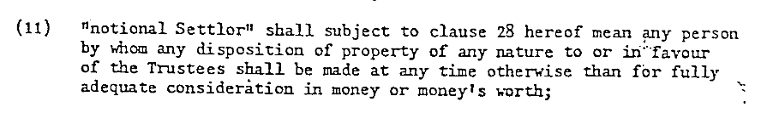
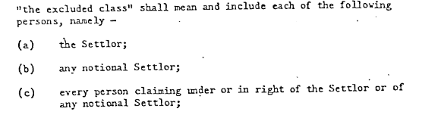
5. I hate your Settlor
Notional Settlor problematic example:
14

Slide 15

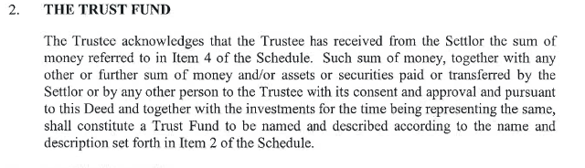
5. I hate your Settlor
Unit Trust subscription problematic example:
Payment of cash problematic example:
15

Slide 16
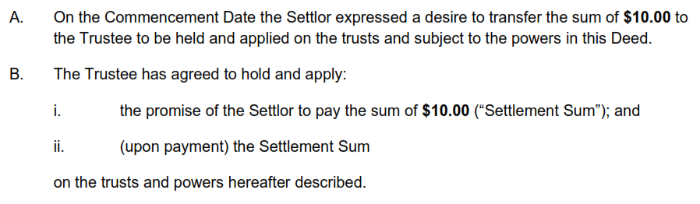

5. I hate your Settlor
Improved example:
16

Slide 17
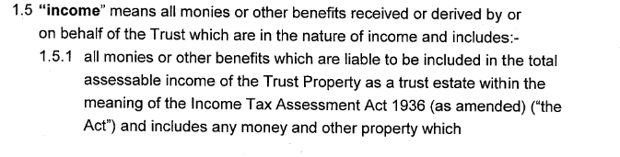
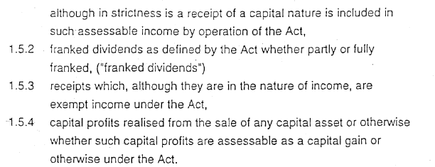
6. I hate your definition of Income
Problematic example:
17

Slide 18
6. I hate your definition of Income
Issues:
Accounting income vs s95 income
Relevant when:
Deductions greater than accounting income
Corpus distribution
Streaming of Franking Credits and CGT
18

Slide 19
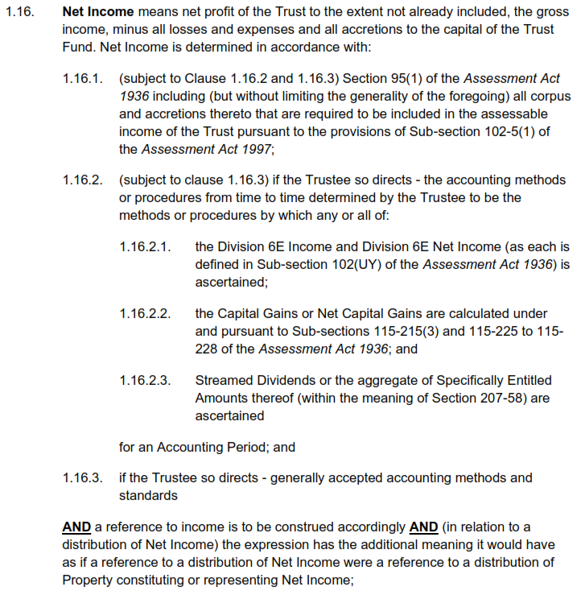
6. I hate your definition of Income
Improved example:
19

Slide 20
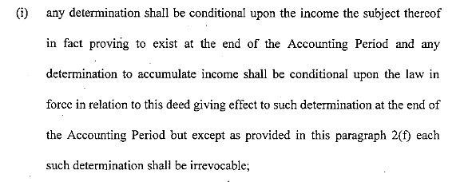
7. I hate proving Income exists
Problematic example:
20

Slide 21
7. I hate proving Income exists
Issues:
Cannot create present entitlement – penalty income tax rates
Improved example:
Delete it
21

Slide 22
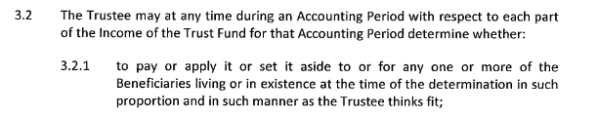
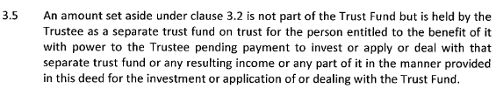
8. I hate your Distributions
Problematic example:
22

Slide 23
8. I hate your Distributions
Issues:
Trust over Income – what is the property?
Other considerations:
Guardians with veto- no present entitlement
Distributions in fixed amounts
Satisfying distributions with property or cash
23

Slide 24
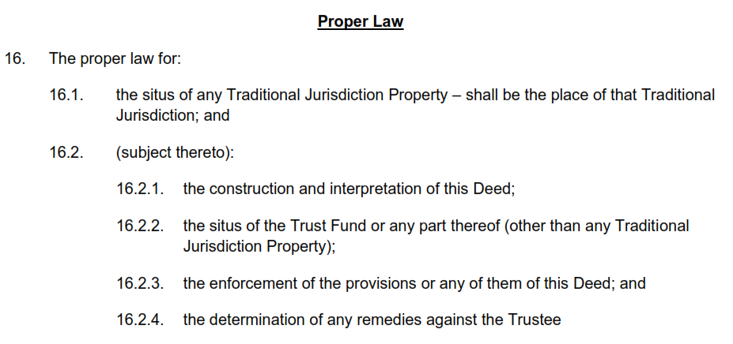
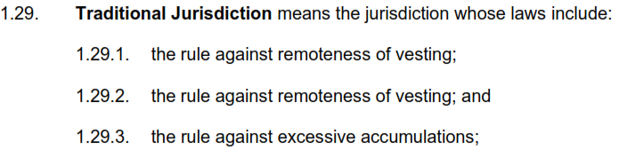
9. I hate the absence of Proper Law
Problematic example:
Improved example:
24

Slide 25
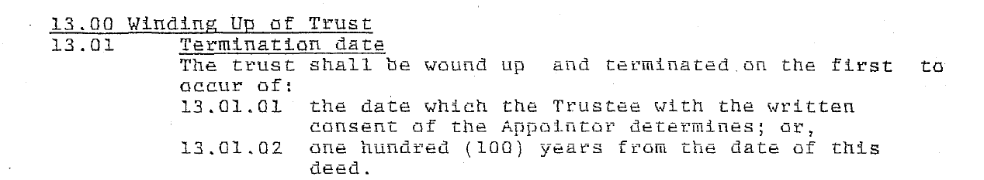
10. I hate failed Perpetuity Periods
Problematic example (pre-1996 in SA):
25

Slide 26
10. I hate failed Perpetuity Periods
Issues:
Pre-1996 SA is void if it is a perpetuity.
Different to remoteness of vesting and accumulation
Trust might acquire property in a Traditional Jurisdiction
26

Slide 27
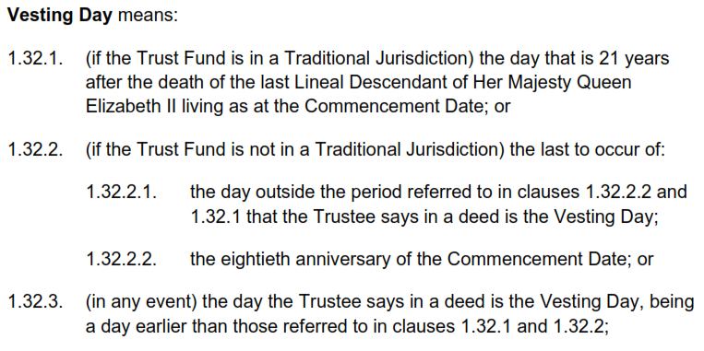
10. I hate failed Perpetuity Periods
Improved example:
27

Slide 28

Contact Us
For questions or more information
ADDRESS
Unit 5, 72 - 78 Carrington Street, Adelaide 5000
PHONE NUMBER
0403 873 498
EMAIL ADDRESS
adrian@cartlandlaw.com

Slide 29
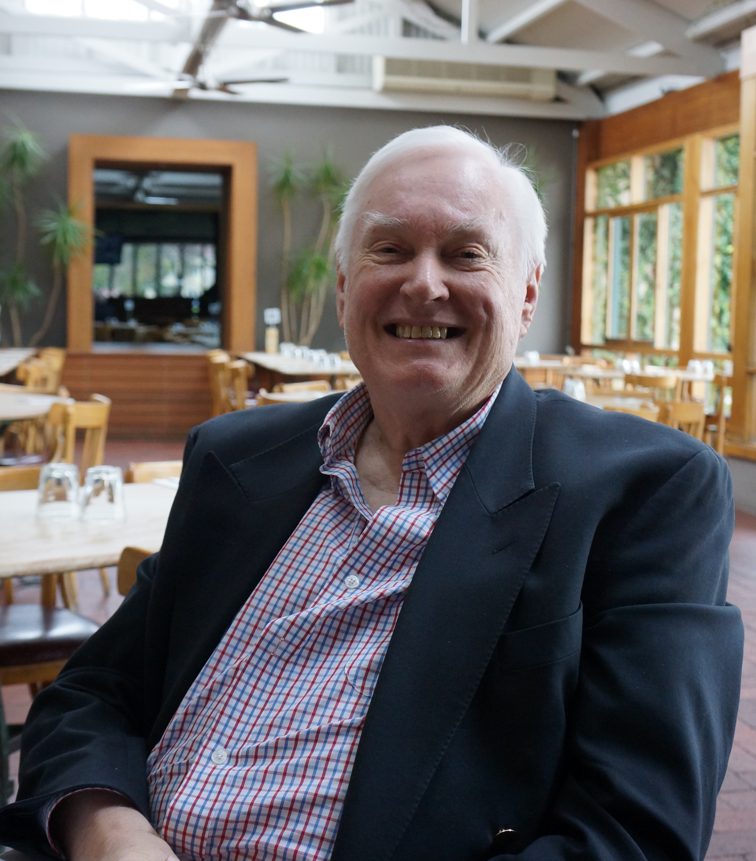

Questions?
Dr Campbell Rankine campbell@campbellrankine.com.au
Adrian Cartland adrian@cartlandlaw.com

